Slide 1



Graduate Orientation 2025
September 8, 2025

Slide 2
Agenda
Important info regarding Grad Studies
CSIT Graduate Seminars (ITEC 5001)

Slide 3

ADGS
Associate Director, Graduate Studies (ADGS)
Marc St-Hilaire - Marc.StHilaire@carleton.ca
Office: CB 4304
Ria Akaiwa - RiaAkaiwa@cunet.carleton.ca
Office: AP 230
You are welcome to pop in without appointment anytime
We would like to hear your suggestions on how to make your experience here better
Graduate admin
Notes:
Update your contact information in Carleton Central

Slide 4

Where to Find information and forms
Grad website: Links, forms, information on Directed Studies and Seminar course: https://carleton.ca/csit/current-students/
CSIT Graduate Manual: https://grad.csit.carleton.ca/docs/CSIT_Graduate_Students_Manual_2025.pdf
  Read it! It has all this information & more!
  Pay attention to deadlines. These are important and if you miss them you may end up having to pay for another term.
  Carleton Policies: https://gradstudents.carleton.ca/graduate-supervision-responsibilities-expectations-policy/

Slide 5

Courses
Core vs Elective
ITEC5001: Seminar series: All students required to present (x1) and attend (x8). Also, your time to socialize and meet each other.
Directed Study/NET projects: (elective) requires a course outline & registration form
Register for your winter courses now (after discussing with advisor/supervisor)

Slide 6

Advisors (Course-based programs)
Who is my advisor? It’s listed on your admission offer
Your responsibility to contact them.
Send an email to introduce yourself, let them know you’re here, and set up a meeting to discuss courses you are taking this term & planning on next term
Check in (at least) once a term minimum with progress reports

Slide 7

Supervisors (thesis students)
Send an email to let them know you’re here & set up a meeting
Check in (at least) once a term minimum with progress reports
  Ideally more during the research phase

Slide 8

Typical deadline dates
PhD qualifying exam: last day of exams in a term (as set in the calendar https://calendar.carleton.ca/academicyear/ )
PhD proposal: last day of exams in a term
  Work must be submitted one month prior
PhD defence: last day of classes in a term
  Work must be submitted 2 months in advance of that date
Master’s defence: last day of classes in a term
  Work must be submitted one month in advance of that date.

Slide 9

Extension Requests
Extension requests are NOT taken lightly.
Must have a legitimate reason for requiring an extension.
They involve a lot of paperwork and meetings on our side, so do NOT just use an extension because you procrastinated. It will be rejected.

Slide 10
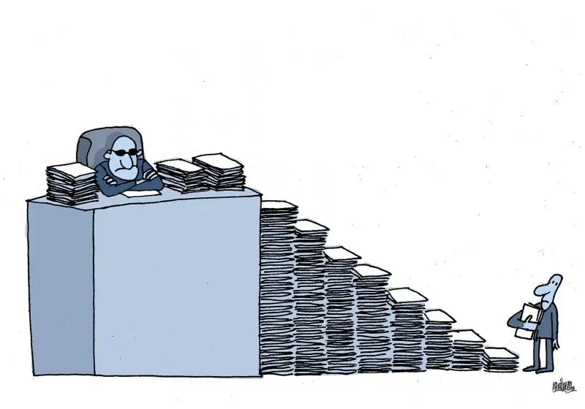
We need to sign off on all your forms
Give us at LEAST a week to sign forms. They must go through several layers of bureaucracy (advisor/supervisor -> Ria -> Me -> Graduate Studies).
YOU CANNOT leave a form to the last minute/last day it’s due. It does not give us enough time. We get sick, take days off, etc.

Slide 11

Scholarships & Awards
Many opportunities for domestic & international students –search and talk to your supervisor/advisors about them
Apply (if you meet the requirements)!
  Many don’t get a lot of applicants

Slide 12

Travel funds
Faculty of Graduate and Postdoctoral Affairs provides some funds to travel to conduct/present research (up to $500)
Applications considered on case-by-case and 1st come 1st served basis.
One application per year
Must be submitted at least 1 month in advance https://gradstudents.carleton.ca/awards-and-funding/internal-awards/#travel

Slide 13

TAing
You must be registered full time
Accept the TAship as soon as you can
Set up an account with HR before you can be paid (Do that now!)
Be honest with skillsets so you can be assigned appropriate work

Slide 14

Academic Integrity
As our understanding of the uses of AI and its relationship to student work and academic integrity continue to evolve, students are required to discuss their use of AI in any circumstance not described here with the course instructor/supervisor to ensure it supports the learning goals for the course/program.
Keep in mind:
  You may not use AI to produce any part of your content. See our AI integrity statement on the grad website.
  Just because we don’t have the tools to detect accurately now doesn’t mean they won’t be able to detect in future: Don’t have this hanging over you the rest of your life! Degrees can be revoked!
  AI is often wrong!
  Copying data to AI is likely an ethics breach—this data does not get deleted.

Slide 15
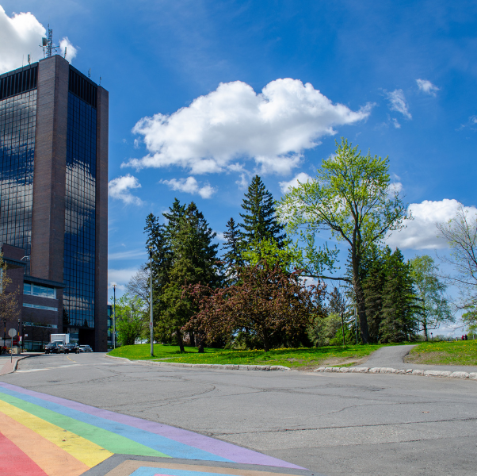
Campus Resources

Slide 16

Get a desk!
We have desk space for you to work in.
Ask your advisor/supervisor
Decorate it, and use it! We want to see you around!

Slide 17

Dedicated Study Spaces
Library also has quiet rooms you can book.
Library also runs support for citation management, etc.

Slide 18
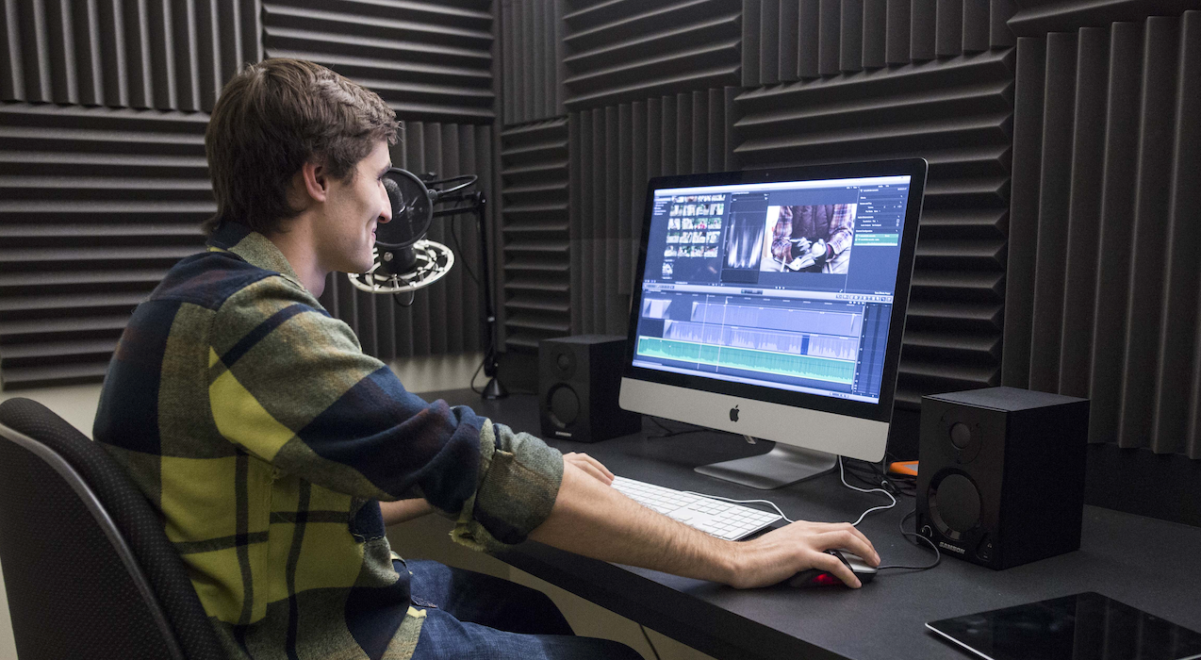
CSIT Labs
Sound (recording, mixing)
Maker Space
Motion Capture & Greenscreen
Computer labs
Servers with GPU
Etc.
There are also other labs on campus, e.g. anechoic chamber, media production labs, etc.
Talk to your advisor/supervisor if you need equipment.

Slide 19

Graduate Students’ Association
Services, advocacy and community
Medical, dental and accident insurance plans
Grant and award information
Professional development

Slide 20

Academic Support
Centre for Student Academic Support: Educational programs and services
In-person and virtual workshops on academic skills and strategies
E.g. writing, editing, work-life balance, motivation, procrastination, etc.

Slide 21

Professional Development Opportunities
Take advantage of these—past students have said they were very helpful!
Our two flagship programs are designed to help you focus your professional development activities:
  Your Career Narrative program offers advice and tools intended to assist you as you plan your career and hone your overall PD strategy
  Trajectories offers you the opportunity to enhance your skillset by earning non-credit certificates in the areas of writing, communications, and research.
Notes:
PD = Personal Development

Slide 22
CUPE 4600
The union representing Teaching Assistants, Service Assistants, Research Assistants and Contract Instructors at Carleton University.
cupe4600.ca
info@cupe4600.ca
613-520-2600, ext. 4600

Slide 23

Department of Equity and Inclusive Communities
in person, over Microsoft Teams, or via telephone during our regular business hours (8:30 a.m. to 4:30 p.m., Monday to Friday).
Provides education, training and professional development
Sexual violence prevention and survivor support

Slide 24
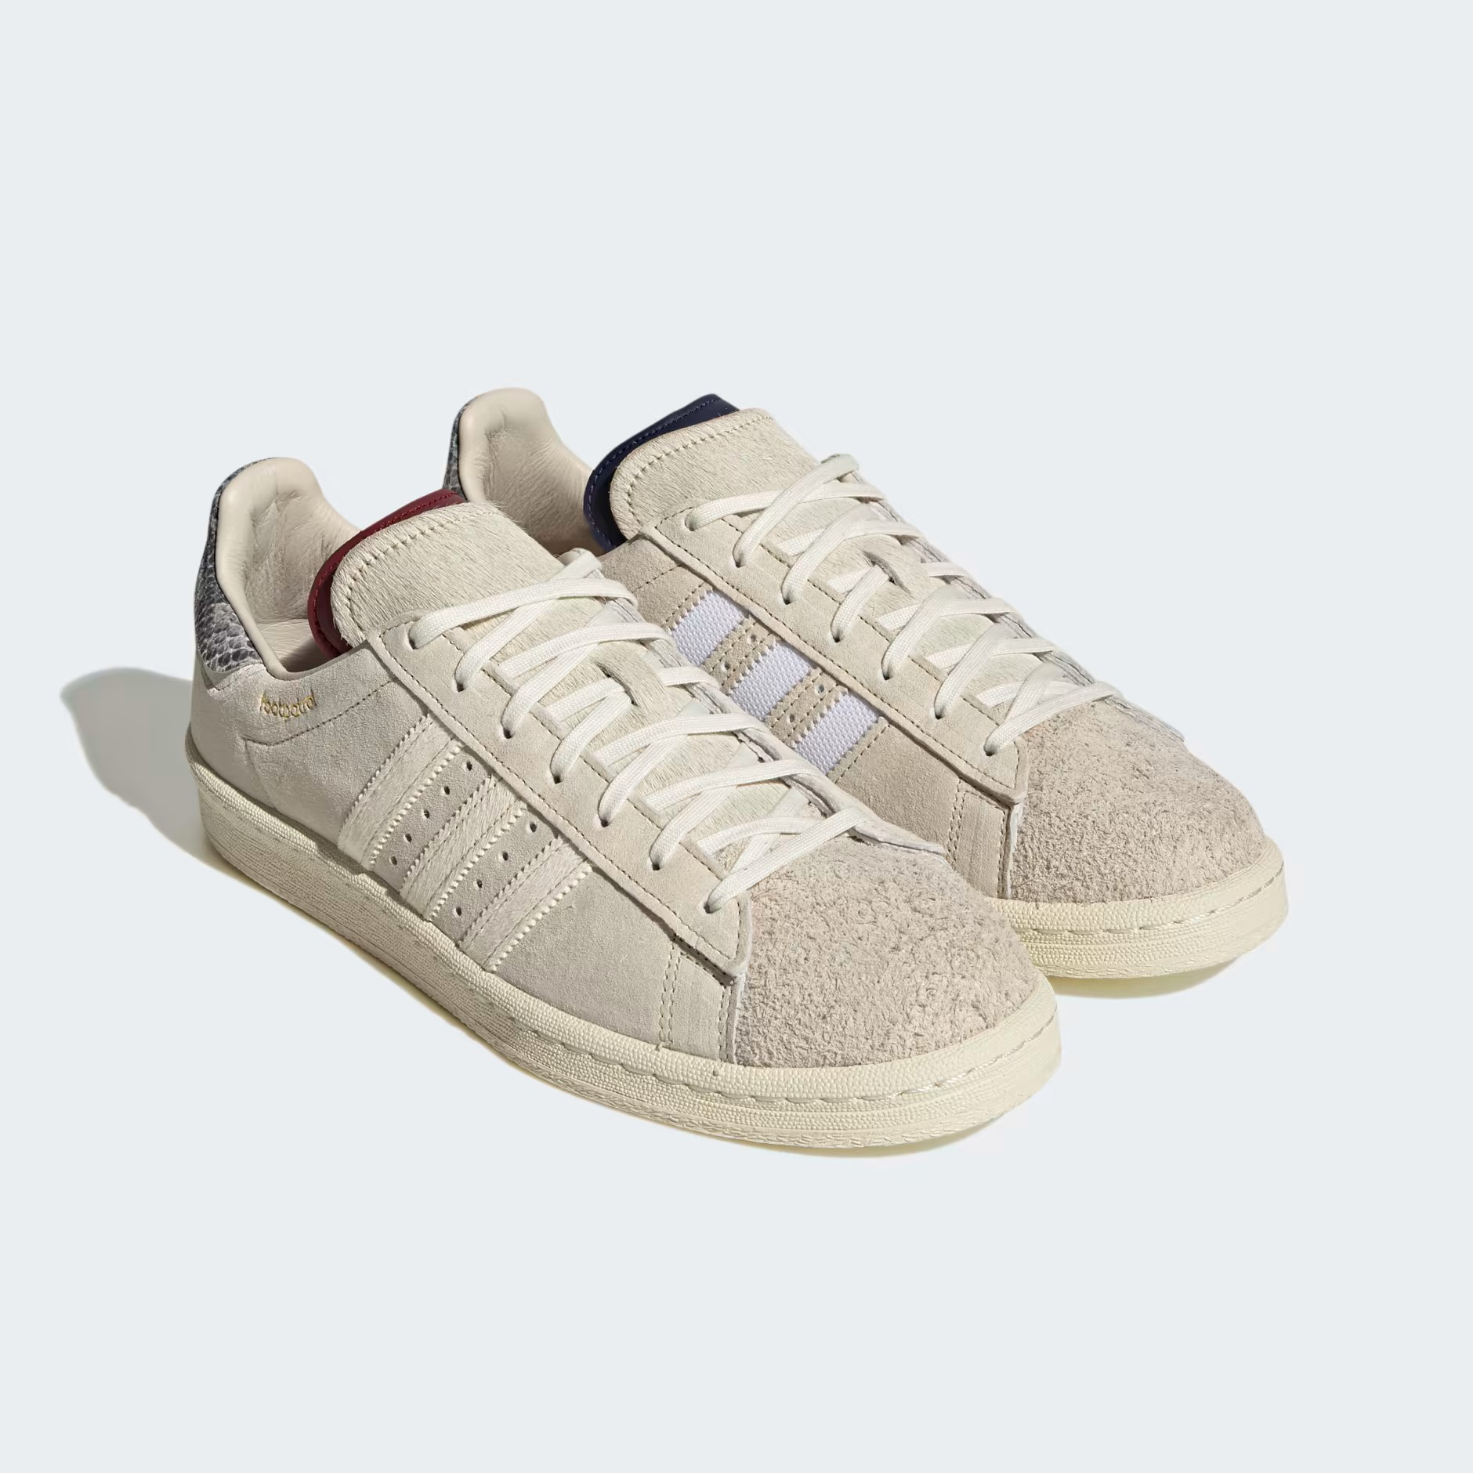
Foot Patrol
Offers safe walks, the Walk and Talk service, Guardian Program event teams, and the Borrow a First Aid Kit service from 6 pm to 2 a.m., 7 days a week.
Off campus walks as well.
cusaonline.ca/footpatrol

Slide 25

Print Shop
Can print posters for conferences, etc.

Slide 26
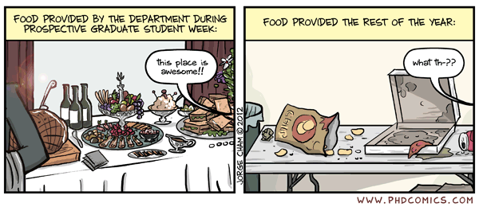
Urgent need food support
CUSA Unified Support Centre: Hamper request form
Works with Ottawa Food Bank
Students limited to 2 hampers per month under emergency assistance

Slide 27
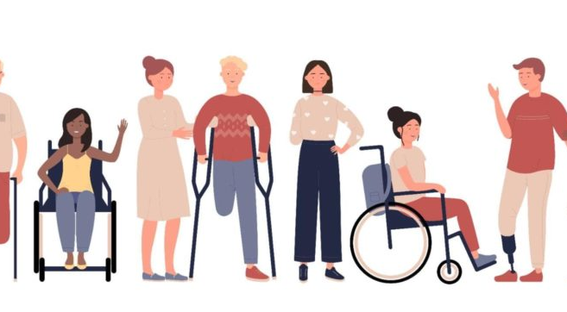
Paul Menton Centre
For students with disabilities
Provides accommodation letters and support, services and resources

Slide 28
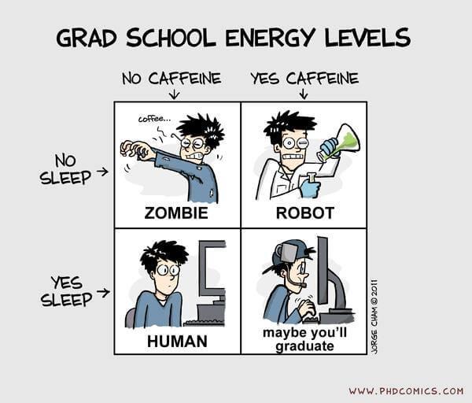
Mental Health Supports
Check out university’s Wellness Services Navigator: helps you find resources
Dedicated grad student counsellor in Health & Counselling Services

Slide 29
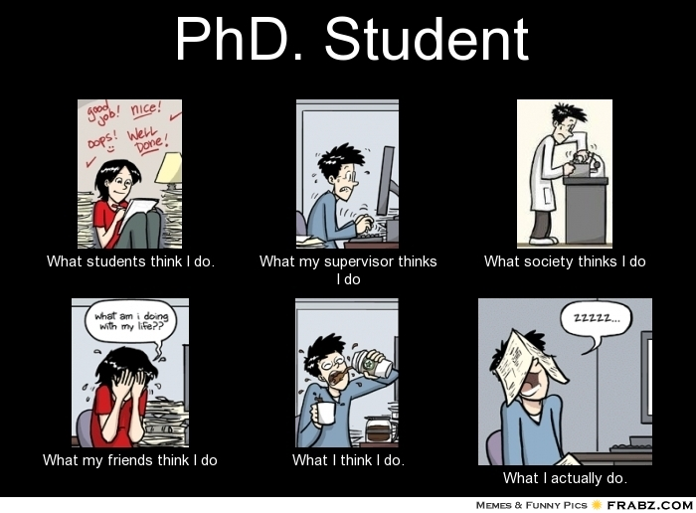
CSIT Grad Society??
Doesn’t exist!
It’s up to YOU to organize and run!
Could be for mutual support, organize social events, etc.
Discord server:
https://discord.gg/pXhyyZCMdT

Slide 30
Check out & Connect on the socials…
@Grads at Carleton on Youtube
https://www.csit.carleton.ca/index.php?pageID=GradInfo
@CarletonIT on X (Twitter), Insta, etc.
Grad studies will be a wonderful time in your life!
Try to get involved in extra-curricular activities and campus life!
Final words:

Slide 31
CSIT Graduate Seminars
Dr. Jaisie Sin (Seminar Coordinator Fall 2025/Winter 2026)
Fall 2025

Slide 32
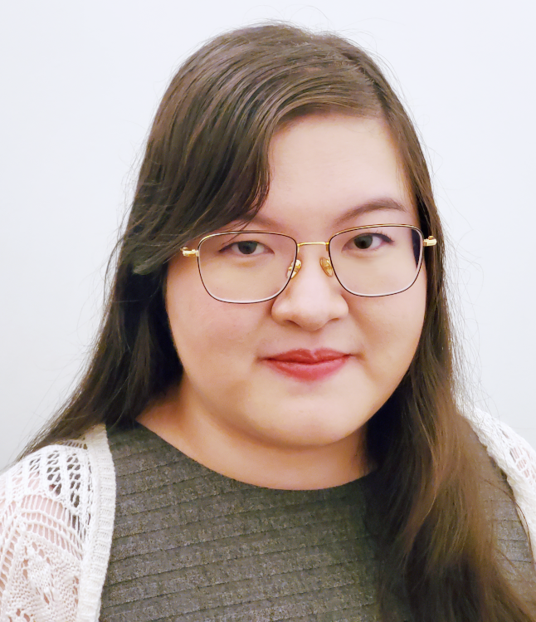
Your Seminar Coordinator
Assistant Professor, Carleton School of Information Technology
What to call me: Jaisie, Professor, Prof Sin
Undergrad in Computer Science & Neuroscience (UofT), Master of Information in UX (UofT), PhD in Information (UofT)
Email: jaisie.sin@carleton.ca
Seminar Email: CSIT-Seminars@cunet.carleton.ca
Webpage: jaisiesin.com
Linkedin: https://www.linkedin.com/in/jaisiesin/

Slide 33
ITEC5001 Graduate Seminars – What are they?
Seminars and lectures given by students, faculty, and visitors
All CSIT Masters and PhD students are required to attend at least 8 seminars and present at least once
  PhD students returning after a Masters need to do ITEC5001 again
Schedule (view only): https://docs.google.com/spreadsheets/d/1BcHcJfdIeTNZoBX0FCZgBZplO-BpB6LvFvtdIWUw5_g/
  Two presentations slots per day

Slide 34
How It Works – Attendee
Sign the attendance sheet to record your ITEC seminar attendance
Each seminar session (whether there is 1 or 2 presentations) count as 1 attendance credit
External events may count towards ITEC seminar attendance. Instructions:
  Inform the seminar coordinator about your intent to use this option and request permission.
  Complete an attendance form signed by the event organizer
Late Policy: Late by more than 10 minutes would not count for attendance
To check your attendance, email the Seminar Coordinator email address with the word "attendance" in the subject line (not live yet but will be after next week)

Slide 35
How It Works – Presenter
Presenter slots are 30 min long.
  ~20-25 mins long presentation, and with ~5-10 mins for Q&A
Any academic topic, including lectures, research talks, and project presentation
Keep in mind your audience! NET and DM students & faculty
Should be polished and professional. No close reading off screen or notes!
Email seminar coordinator to register. Include title and which date/time you want. Send 150-250 word abstract by Wednesday before your talk.
No double-dipping – You do not get attendance credit for your own presentation
  But you can get attendance credit for any others’ presentations on the same day

Slide 36
When to “Register” for ITEC5001
When you have attended 8 presentations & presented once, register for ITEC 5001
If you meet these requirements for ITEC5001, you will receive your credit (pass/fail) for this course during that semester

Slide 37
Quick Links
Seminar Coordinator Email: CSIT-Seminars@cunet.carleton.ca
Seminar Schedule (view only): https://docs.google.com/spreadsheets/d/1BcHcJfdIeTNZoBX0FCZgBZplO-BpB6LvFvtdIWUw5_g/

