Slide 1
Teaching with XR – Ali Arya

Slide 2
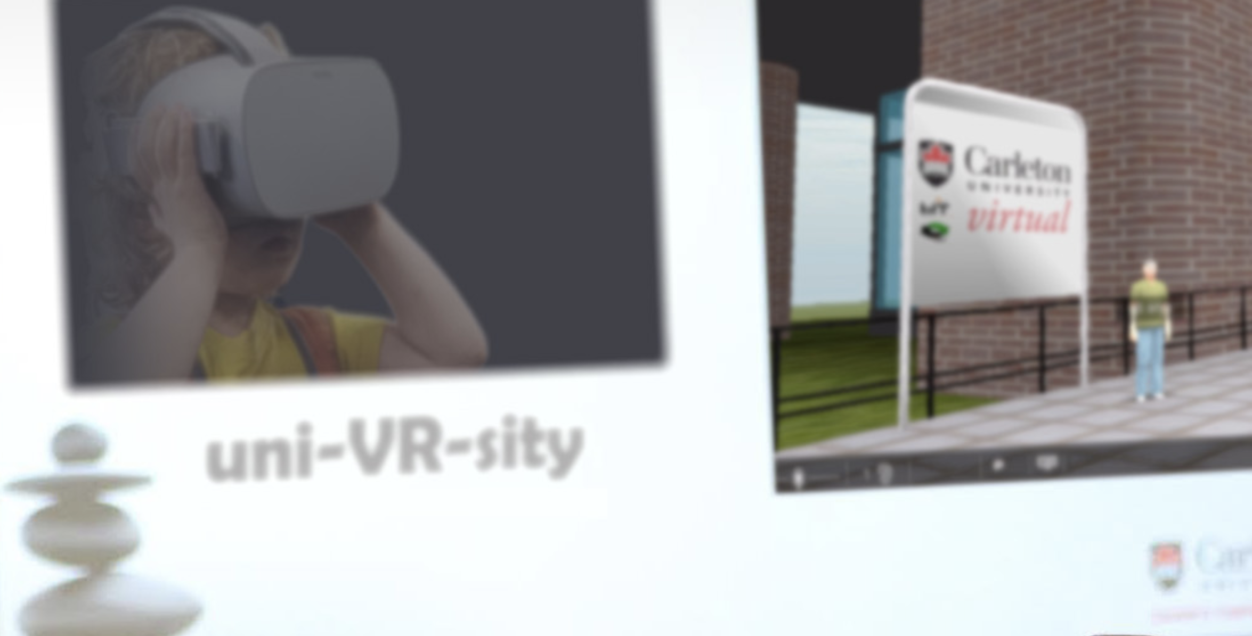
About Me
School of Information Technology
Interactive Multimedia
Games, VR, HCI, Ed Tech
Worked on VLE since 2010
Carleton Virtual
Immersive Technologies since 2013
AR for customized classroom information
Inclusive VR
Multi-platform Web-based
Accessible
Community-engaged
http://img.csit.Carleton.ca

Slide 3
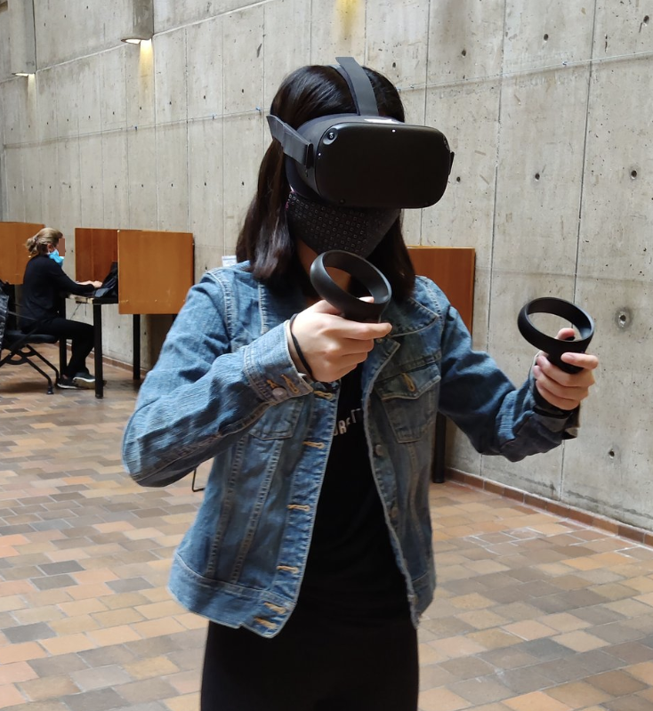
My Teaching
Undergrad Teaching
Intro to multimedia
Programming and software design
Game Design and development
Grad courses
Research methods
Interdisciplinary research
Interactive media and digital art

Slide 4
Teaching Innovation Fellowship
Continuing work started from other funding sources
Multi-platform VR for Education
CIRCLES framework
Management interface
Revised application library
VR-based course modules
Cognitive Science
Physics
Biology
Other VR-based educational experiences
Indigenous gathering place

Slide 5
Involving Students
The VR projects was not used directly in my own courses.
On sabbatical and admin leave for two years!
Developing a framework that can be used by all instructors.
The VR framework has provided examples and tools in some of CSIT courses.
The project has directly engaged students from my courses as research assistant.

Slide 6
Why use XR in teaching
Unique affordances: Immersion, Interaction, Visualization
Increased engagement and understanding
Additional tool together with others
A new educational paradigm: In-class, distant, virtual (zoom to VR), Hybrid

Slide 7
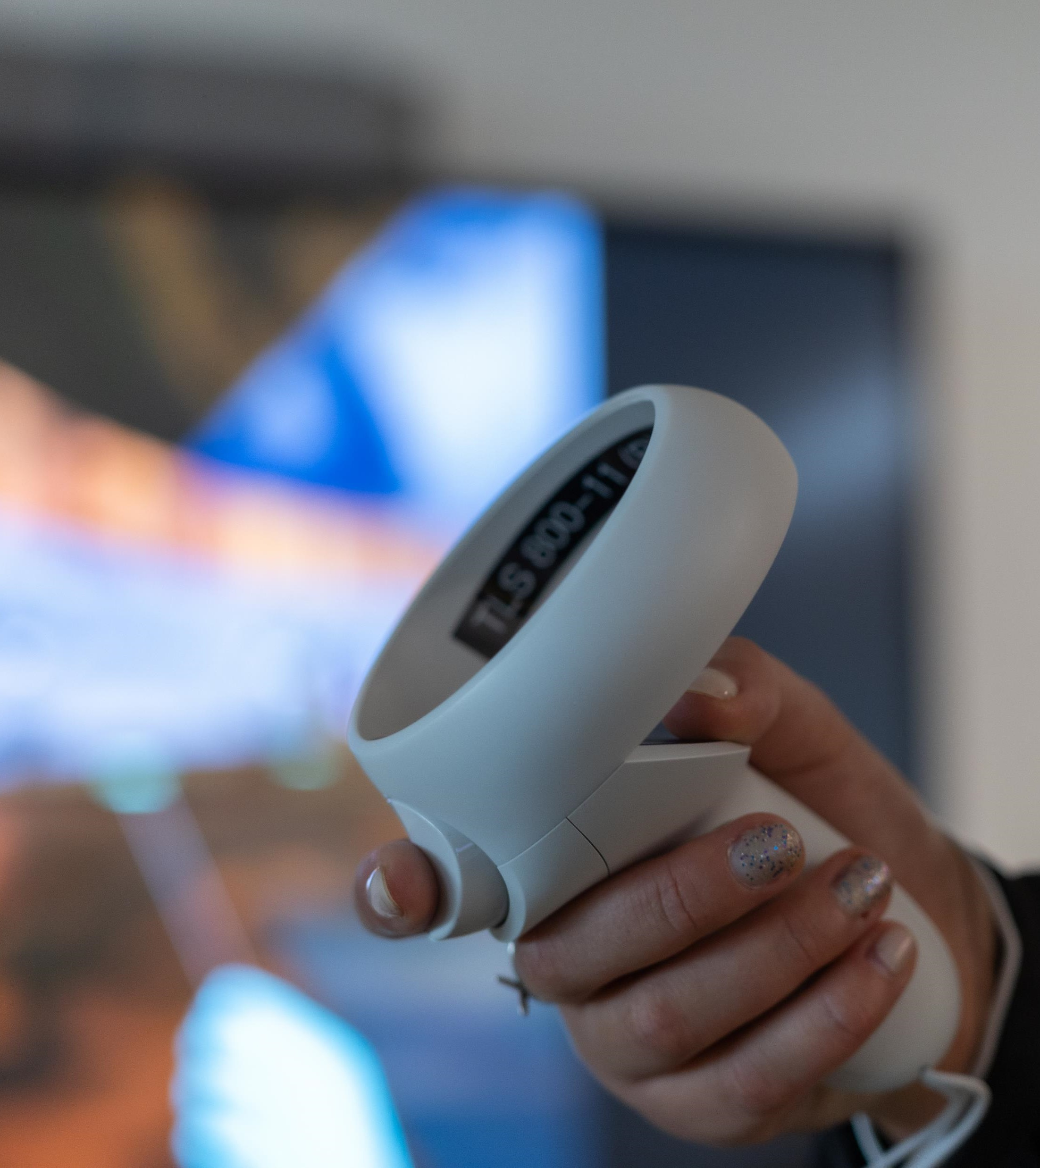
Changing dynamics in the classroom
Positive
Creating experiences that are hard or impossible to have in physical world
Convenience of working from “anywhere”
Programmability and customization for personalized and accessible experience
Combining with AI
Negative
Losing some personal connection and in-person conveniences
Technology difficulties
Cost of development vs. gained advantages

Slide 8
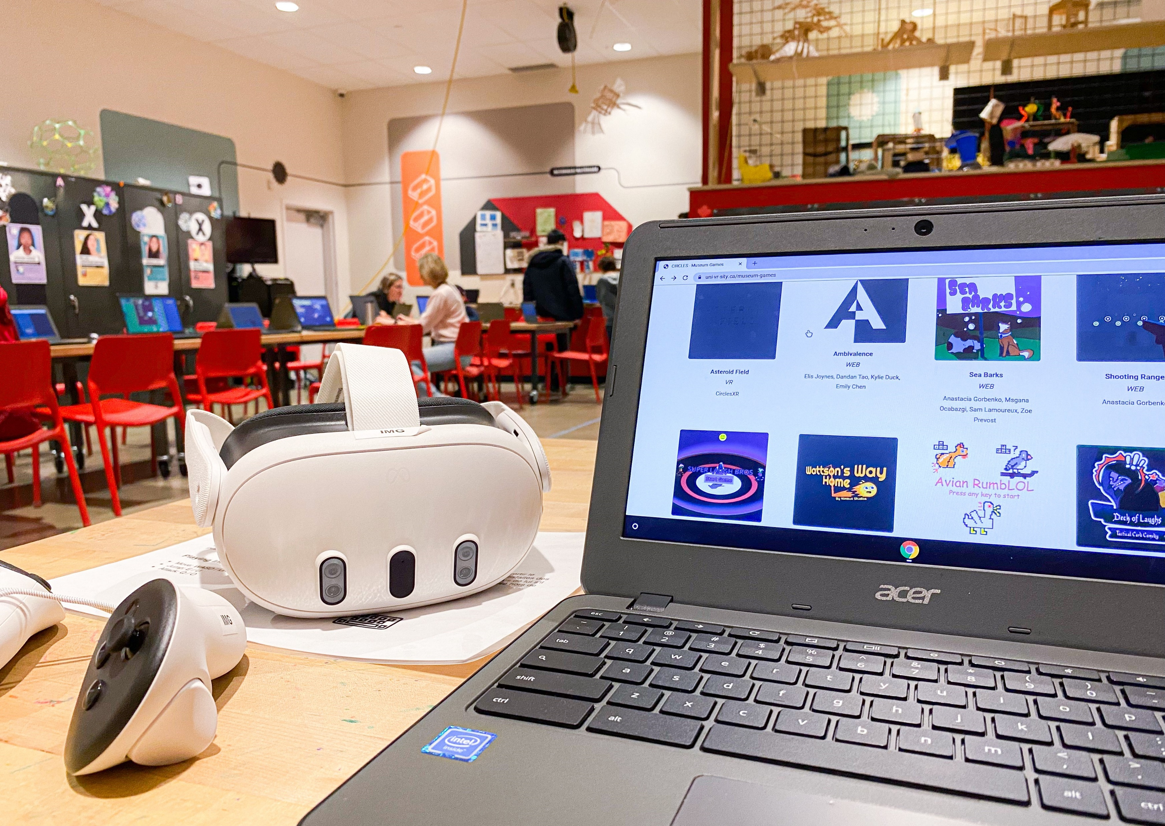
Experiential Learning
Simulating hands-on tasks
Simulating various environments and situations
Ability to add intelligence
Does not replace “real-world” experience
Increased accessibility and inclusion
Although XR has its own inclusion issues to be resolved

Slide 9
Risks
Scaring or overwhelming learners due to technology overhead
Oversimplifying the experience resulting in limited or incorrect understanding in learners
Causing new inclusion issues
Under-utilization due to limited added value
Over-reliance and ignoring real-world experience

Slide 10
Barrier
Purchase and deployment cost
Design and development
Needs collaboration of many groups
Adoption by educators
Needs learning new things and adjusting methods
Adoption by learners
Needs being convinced of advantages and overcoming difficulties
Inclusion
Should be inviting and engaging for different groups
Suitability
Not for every learning activity
Needs more research

Slide 11
Benefits
Increased engagement : Can be temporary though (wow factor)
Better visualization and understanding: Not for all subjects
Customizable: For inclusion and accessibility

Slide 12
Future thoughts
Needs more research to work on mentioned risks and barriers
Inclusion
Suitability and efficacy
Personalization and combining with AI
XR-based pedagogy

Slide 13
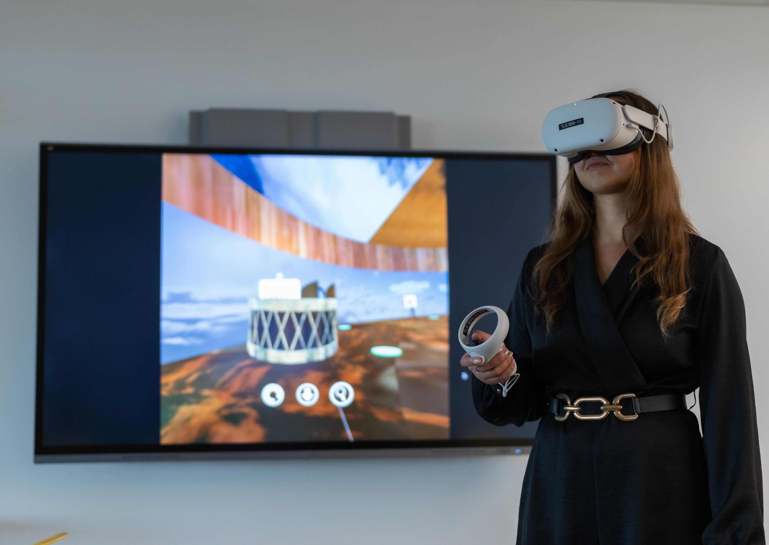
Getting started
Lower expectation
No tool is going to solve all problems
Combining with in-person, zoom, and other tools
Use low-cost and “portable” experiences
Web-based frameworks may be the future
Experience with high-end products
They will become cheap soon
Invest time (and other resources)
It can take significant resources to do XR right
Form partnerships
Contact TLS

Slide 15
Q&A
What worked well?
Support from TLS
Working with students
Connecting to other faculty members in
What accessibility considerations did you make?
Accessibility was a key goal of the project. The main achievement was the multi-platform design, and starting inclusive sub-projects.
Did your project impact student learning?
Too early to say.
What were some of the challenges?
Finding instructors who have time to invest on XR development
Working with students who have academic pressure and obligations
What would you do differently?
Focus on one partner/course
What would you do the same?
Engaging undergrad students in the development
What is next?
Improving the framework and its usability for instructors
Running studies to see the effect

