Slide 1
Pedagogical Training for Faculty Members: Insights from a Survey
Ali Arya
Adrian Chan
Kim Hellemans
David Hornsby

Slide 2
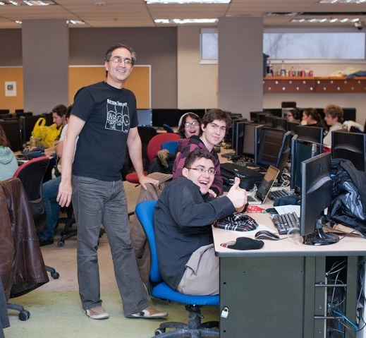
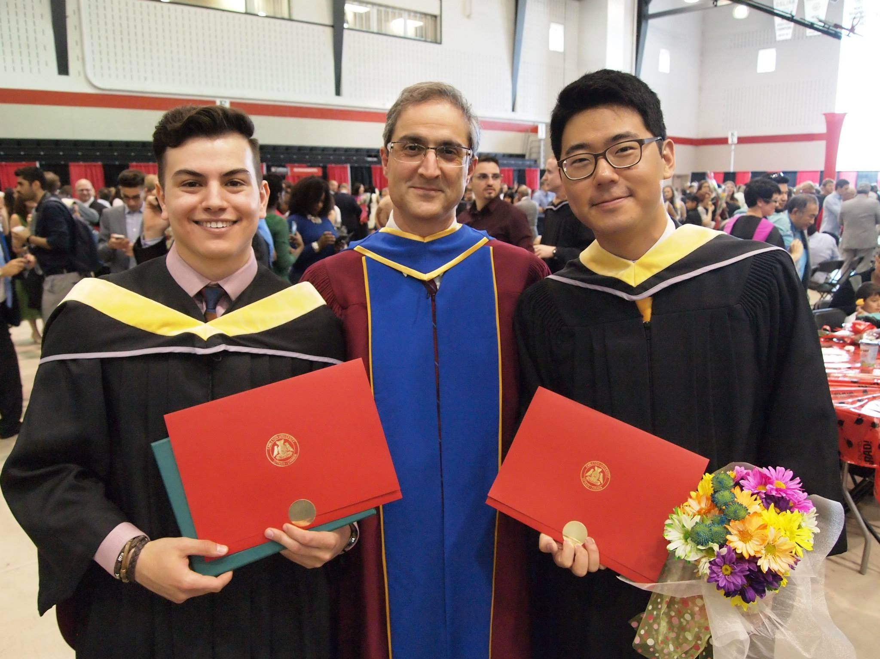
Faculty Members: Experts Helping Students Learn
But Are We Really
Experts?
In What?

Slide 3
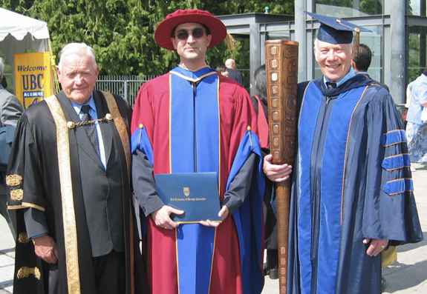
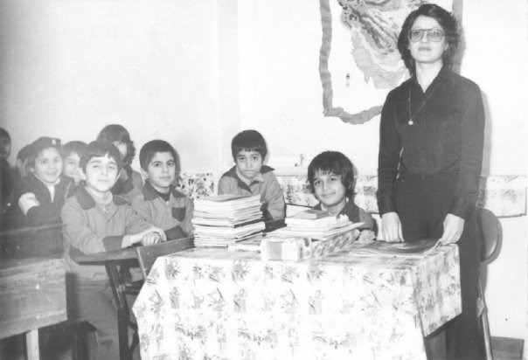
We Were Students Ourselves. For A Long Time!

Slide 4
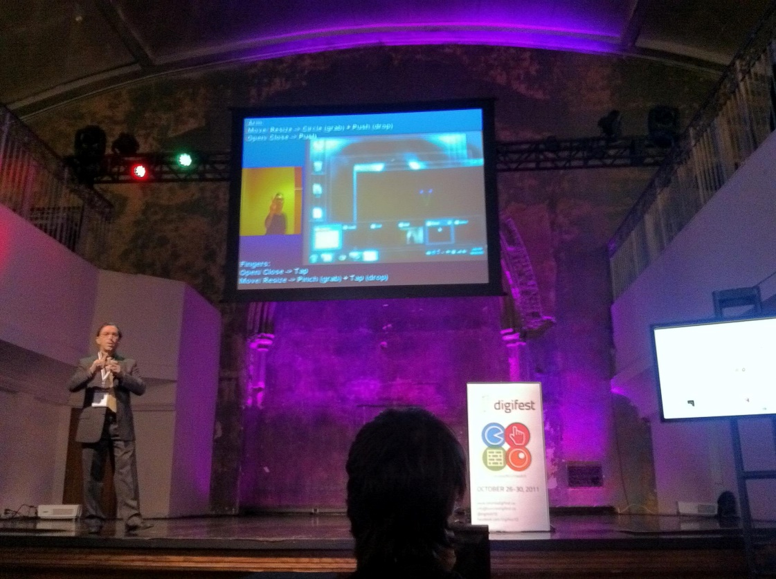
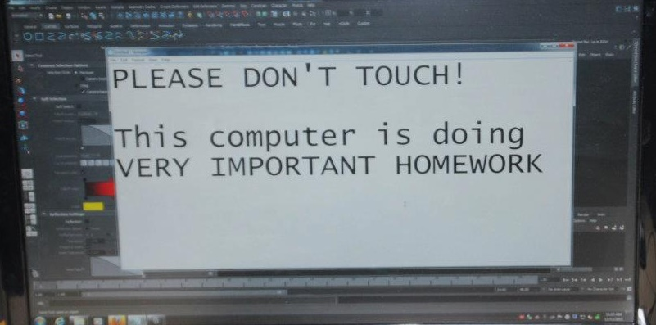
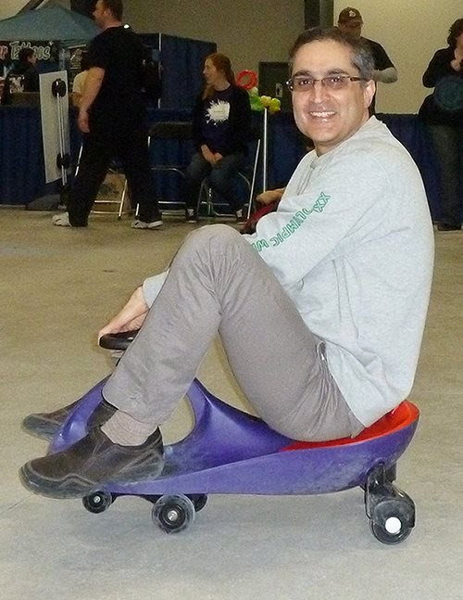
We Learn How To Do Research

Slide 5
Is being an expert on a subject enough to be an educator?
Pedagogical Skills such as:
Course Design
Course Delivery
Evaluation and Assessment
Educational Technology
Student Well-being
Emotional Intelligence
“It is sometimes wryly noted that college [university] teaching is the only profession requiring no formal training of its practitioners.”
Nowlis et al., 1968

Slide 6
Motivations
Research shows that faculty training can improve their performance and student experience.
The existing training programs are limited.
The real training needs and interests of faculty members are not well known. Neither are their current sources of training.
While traditional training programs commonly focus on course design and delivery, training on other pedagogical skills such as those related to well-being and social and emotional support are rarely available.

Slide 7
Student Well-being: Not Just for Counseling Services
Notes:
Student mental health has been the focus of many discussions and investigations over the past few years. The topic was a serious concern prior to the COVID pandemic and increased in significance in the last two years. Our prior work, based on a student survey, showed that problems affecting students’ mental health are frequently associated with their academic work. It suggested that there is a divide between counselling services and academic support, and academic planning is too focused on cognitive aspects of learning. This leaves students without proper emotional support.
Students’ well-being requires defining best practices for faculty and training faculty members on those practices, in addition to topics such as emotional intelligence. These should lead to strategies that integrate emotional aspects into academic activities. What is not quite clear, though, is what the faculty themselves think in terms of the training they need or want.

Slide 8
Research Method
Survey of full-time faculty members at Carleton University
All levels and programs
Generic pedagogical skills
Course design, course delivery, assessment, educational technology, mental health and well-being, and emotional intelligence
Questions on needs, interests, and sources of training
32 questions
Fall 2021, 144 respondents
48% male, 45% female, 7% other or prefer not answer
Fairly balanced distribution in number of years
62% humanities and social sciences, 38% engineering and natural sciences

Slide 9
Highlights of Findings (https://www.csit.carleton.ca/~arya/FacultySurveyResults.pdf)
Course design and delivery were considered the most important, but student well-being and educational technology were least prepared (both at the start of career and now), followed by course design, assessment, and emotional intelligence.
This is the key finding as course design and delivery are the main priorities in most training programs.
There were some gender-based differences:
Male responders felt more prepared on Ed Tech than females
(2 vs. 3 out of 5, median).
Female responders were slightly more interested in training than males (about 5-10%).
There were some level-based differences:
Assistant professors were about 10% higher than average on all training needs except ed tech.
Associate professors were about 10% lower than average on all training needs.
Full professors were close to average on all except EI where they had above average need.
Incentives were considered essential for attending formal training, due to limited time and resources.
Counting towards service or teaching duties was the most preferred incentive (39%), followed by counting towards performance evaluation (28%) and being mandatory (14%).

Slide 10
Main Take-away Messages
Many faculty members are not properly trained and prepared for their educational tasks.
Student well-being is considered mainly a counseling service and not prioritized in faculty training.
UNPREPARED
Faculty members are interested in training but face too many expectations.

Slide 11
A Holistic Solution
Faculty training has to be part of a holistic approach to solve educational problems that takes into account:
The growing and dynamic student and faculty population
The fast-paced evolution of technology
The nature of university research and its increasing emphasis on social impact
Equity, diversity, and inclusion concerns for faculty and students
Other social, cultural, economical, political, and environmental factors

Slide 12
A Brief Look at the Survey Data

Slide 13
Likert Scale Questions
9. How prepared do you think you were for your first academic position?
14. How important do you think the following skills are in teaching?
15. How much training do you think you currently need for the following skills?
16. How likely are you to attend a formal training for the following skills?
19. How much do you think you are valued by your employer based on your skills in the following duties?
23. How much do you feel this formal training prepared you for your first academic position?
27. How much do you feel this informal training prepared you for your first academic position?
29. How much do you feel the first-hand experience prepared you for your first academic position?

Slide 14
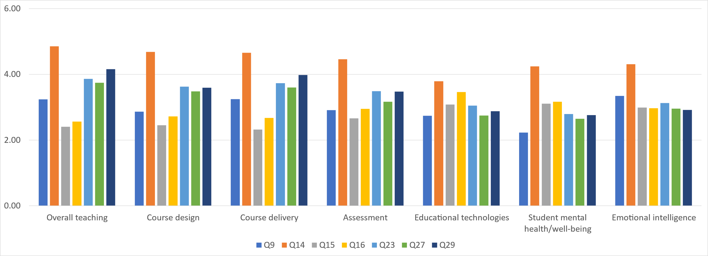
Summary of Responses

Slide 15
9. How prepared do you think you were for your first academic position?
1 (Almost not at all) | 2 | 3 | 4 | 5 (Very much) | N/A
In general, not very prepared for understanding student mental health and well-being, and how to use educational technologies, but well prepared for course delivery and overall teaching.

Slide 16
Q9. Other, please specify:
Items | Score
Team collaboration | 4
Inspiring students | 5
Technical (content) skills | 5
Balancing teaching and research | 1
Structure of / roles within universities | 1
LMS | 2
Student cheating | 1
Coaching and interacting with younger people | 5
Specific students’ culture at Carleton | 1
Course management software – not part of e. because they don’t educate | 1
Time management | 1

Slide 17
14. How important do you think the following skills are in teaching?
1 (Almost not at all) | 2 | 3 | 4 | 5 (Very much) | N/A
In general, skills for overall teaching, course design and delivery, and assessment are extremely important, but educational technologies, emotional intelligence and student mental health and well-being seem to be less important.

Slide 18
Q14. Other, please specify:
Items | Score
Team collaboration | 5
Maintaining healthy boundaries | 5
Non assessed student activity | 4
Equity, diversity and inclusion EDI | 3
Balancing teaching and research | 5
Conflict resolution | 5
Political and ideological tolerance and pluralism | 5
Equity and inclusion in teaching | 5
Ability to create good rapport | 5
Time management | 5

Slide 19
15. How much training do you think you currently need for the following skills?
1 (Almost not at all) | 2 | 3 | 4 | 5 (Very much) | N/A
In general, need some training for using educational technologies (possibly due to an increase in online teaching), don’t need a lot of training for course delivery, design and overall teaching, and need some training for assessment, emotional intelligence and student mental health and well-being.

Slide 20
Q15. Other, please specify:
Items | Score
Team collaboration | 5
EDI | 1
Balancing teaching and research | N/A
Equity and inclusion | 3
Student cheating | 4
Time management | 4

Slide 21
16. How likely are you to attend a formal training for the following skills?
1 (Almost not at all) | 2 | 3 | 4 | 5 (Very much) | N/A
In general, would most likely attend formal training to improve skills on using educational technologies and guidance about student mental health and well-being, but less likely to attend workshops on EI and overall teaching. Would probably attend course delivery and assessment related workshops.

Slide 22
Q16. Other, please specify:
Items | Score
Team collaboration | 5
Course delivery (lectures) stress me, and I believe I could become better at it, but I will not take training because, precisely, it stresses me, and I don't think I could do it because of anxiety. | ?
EDI | 2
Balancing teaching and research | 2
Conflict resolution | 5
Time management strategies | 5

Slide 23
19. How much do you think you are valued by your employer based on your skills in the following duties?
1 (Almost not at all) | 2 | 3 | 4 | 5 (Very much) | N/A
Ability to conduct research seems to be rated as the most valuable compared to service and teaching.

Slide 24
23. How much do you feel this formal training prepared you for your first academic position?
1 (Almost not at all) | 2 | 3 | 4 | 5 (Very much) | N/A
In general, very little preparation for EI, student mental health and well-being, and educational technologies, felt more prepared about overall teaching, course delivery and design, and assessment.

Slide 25
27. How much do you feel this informal training prepared you for your first academic position?
1 (Almost not at all) | 2 | 3 | 4 | 5 (Very much) | N/A
In general, not very prepared for understanding student mental health and well-being, EI, and how to use educational technologies, but more prepared for course delivery, design, and overall teaching.

Slide 26
Q27. Other, please specify:
Items | Score
I also took courses but I found the "informal advice“ by my peers more helpful. | ?
Balancing teaching and research | 1

Slide 27
29. How much do you feel the first-hand experience prepared you for your first academic position?
1 (Almost not at all) | 2 | 3 | 4 | 5 (Very much) | N/A
In general, not very prepared for understanding student mental health and well-being, EI, and how to use educational technologies, but more prepared for course delivery, design, and overall teaching.

Slide 28
THANK YOU!

